Slide 1
Learning Objective
I will be able to solve multi-stage probability experiments
Success Criteria
At the end of the lesson, I will be able to:
be able to solve multi stage problems involving probability.

Slide 2











Guided Practice
What are the possible outcomes when a fair coin is toss twice?
$$H$$
$$HH$$
$$H$$
$$T$$
$$HT$$
$$H$$
$$TH$$
$$T$$
$$T$$
$$TT$$
Sample space: $\{HH,HT,TH, TT\}$

Slide 3
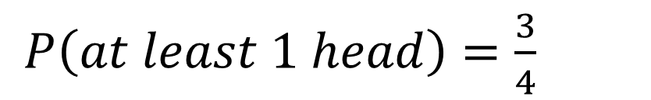
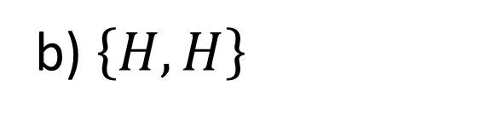
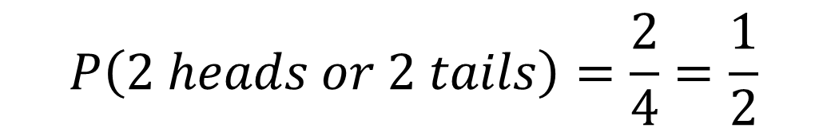
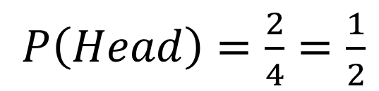
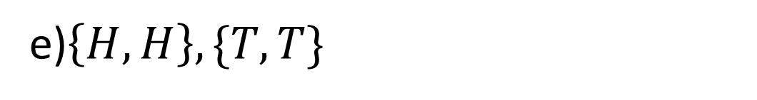
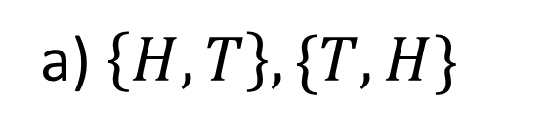
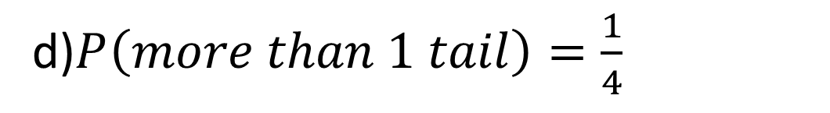
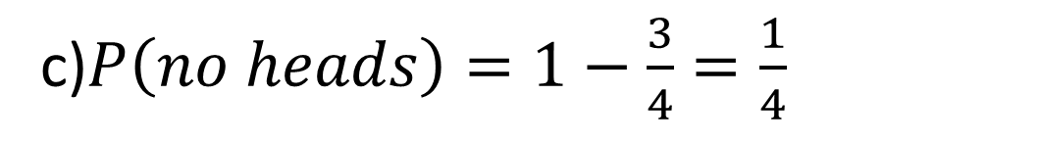
Guided Practice
Find the probability of the following that when a fair coin is tossed twice:
One head is observed
At least one head is observed
No heads
More than one tail
Both heads or both tails are observed
c)$P\left(no heads\right)=1−\frac{3}{4}=\frac{1}{4}$
a) $\left\{H,T\right\}, \{T,H\}$
$P\left(Head\right)=\frac{2}{4}=\frac{1}{2}$
d)$P\left(more than 1 tail\right)=\frac{1}{4}$
b) $\left\{H,H\right\}$
e)$\left\{H,H\right\}, \{T,T\}$
$$P\left(2 heads or 2 tails\right)=\frac{2}{4}=\frac{1}{2}$$
$P\left(at least 1 head\right)=\frac{3}{4}$

Slide 4
Guided Practice
What are the possible outcomes when two fair dice are rolled?
 | 1 | 2 | 3 | 4 | 5 | 6
1 | (1,1) | (1,2) | (1,3) | (1,4) | (1,5) | (1,6)
2 | (2,1) | (2,2) | (2,3) | (2,4) | (2,5) | (2,6)
3 | (3,1) | (3,2) | (3,3) | (3,4) | (3,5) | (3,6)
4 | (4,1) | (4,2) | (4,3) | (4,4) | (4,5) | (4,6)
5 | (5,1) | (5,2) | (5,3) | (5,4) | (5,5) | (5,6)
6 | (6,1) | (6,2) | (6,3) | (6,4) | (6,5) | (6,6)

Slide 5
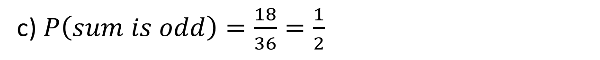
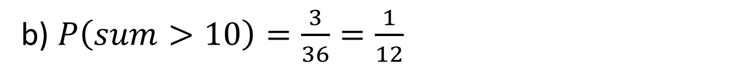
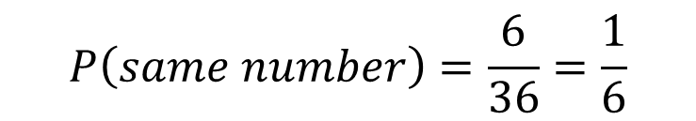
Guided Practice
Find the probability of the following that when two fair dice are rolled:
The same number is shown on both dice
The sum of the two numbers shown is greater than 10
The sum of the numbers showing is odd
a) $\{\left(1,1\right), \left(2,2\right), \left(3,3\right), \left(4,4,\right), \left(5,5\right), \left(6,6\right)\}$
$$P\left(same number\right)=\frac{6}{36}=\frac{1}{6}$$
b) $P\left(sum>10\right)=\frac{3}{36}=\frac{1}{12}$
c) $P\left(sum is odd\right)=\frac{18}{36}=\frac{1}{2}$

Slide 6


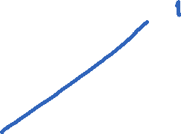



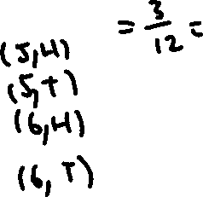
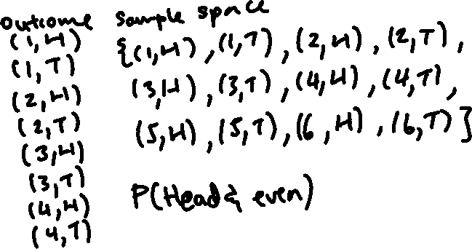



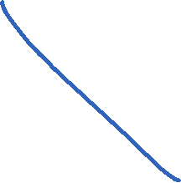


Guided Practice
An experiment consisting of rolling a die and tossing a coin is conducted. Use a tree diagram to list the sample space for the experiment. Find the probability of obtaining a head and an even number.

Slide 7
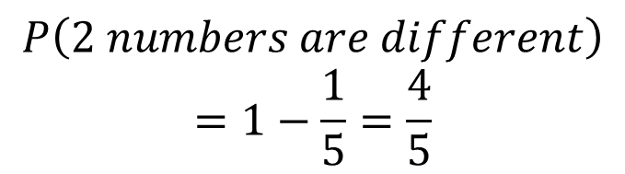
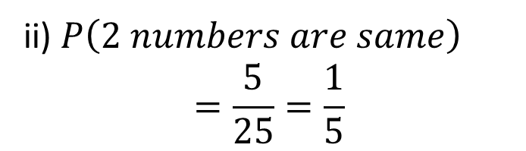
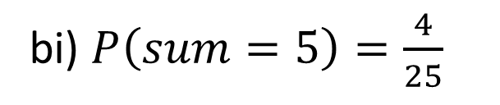
Guided Practice
A bag contains 5 balls, numbered 1 – 5. A ball is chosen at random, the number noted and the ball is replaced. A second ball is then chosen at random and its number noted.
Draw up a table of ordered pairs to show the sample space for the experiment.
Find the probability that:
The sum of two numbers is 5
The two numbers are different
The second number is 2 more than the first.
bi) $P\left(sum=5\right)=\frac{4}{25}$
 | 1 | 2 | 3 | 4 | 5
1 | (1,1) | (1,2) | (1,3) | (1,4) | (1,5)
2 | (2,1) | (2,2) | (2,3) | (2,4) | (2,5)
3 | (3,1) | (3,2) | (3,3) | (3,4) | (3,5)
4 | (4,1) | (4,2) | (4,3) | (4,4) | (4,5)
5 | (5,1) | (5,2) | (5,3) | (5,4) | (5,5)
ii) $P\left(2 numbers are same\right)$
$$=\frac{5}{25}=\frac{1}{5}$$
$$P\left(2 numbers are different\right)$$
$$=1−\frac{1}{5}=\frac{4}{5}$$

Slide 8
Guided Practice
A bag contains 5 balls, numbered 1 – 5. A ball is chosen at random, the number noted and the ball is replaced. A second ball is then chosen at random and its number noted.
Draw up a table of ordered pairs to show the sample space for the experiment.
Find the probability that:
The sum of two numbers is 5
The two numbers are different
The second number is 2 more than the first.
 | 1 | 2 | 3 | 4 | 5
1 | (1,1) | (1,2) | (1,3) | (1,4) | (1,5)
2 | (2,1) | (2,2) | (2,3) | (2,4) | (2,5)
3 | (3,1) | (3,2) | (3,3) | (3,4) | (3,5)
4 | (4,1) | (4,2) | (4,3) | (4,4) | (4,5)
5 | (5,1) | (5,2) | (5,3) | (5,4) | (5,5)

Slide 9


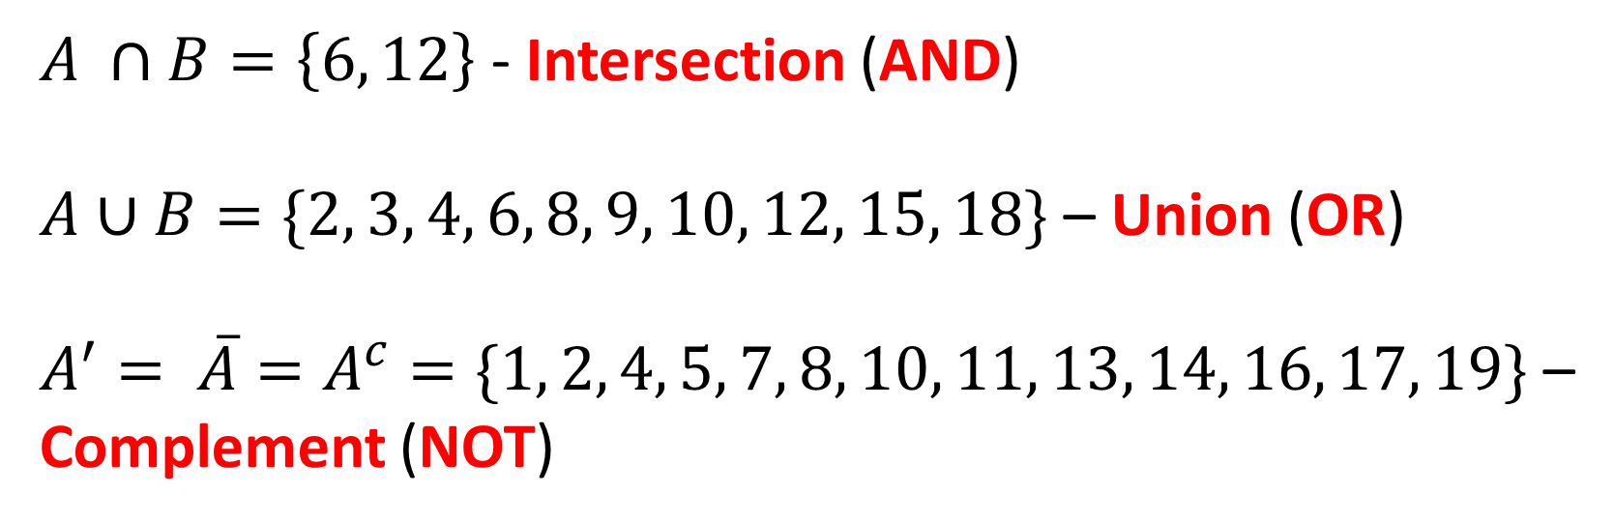

Intersection, union and complement
Concept Development
$$U$$
17
$$A$$
$$B$$
19
6
2
14
3
9
4
8
15
12
10
18
7
1
11
13
16
5
$A ∩B=\left\{6, 12\right\}$ - Intersection (AND)
$A∪B=\{2, 3, 4, 6, 8, 9, 10, 12, 15, 18\}$ – Union (OR)
$A^{′}= \overline{A}=A^{c}=\{1, 2, 4, 5, 7, 8, 10, 11, 13, 14, 16, 17, 19\}$ – Complement (NOT)

Slide 10
Mutually exclusive events
Concept Development
These events cannot occur at the same time.
Example
tossing a coin
cannot have both head and tail at the same time
rolling a die
rolling an even and odd number cannot happen at the same time
rolling an even and prime number can happen at the same time
coming to school
being driven to school in a car cannot happen at the same time as riding a bicycle

Slide 11
How is this shown in a Venn Diagram
Concept Development
U
U
B
A
A
B
C

Slide 12
Guided Practice
A card is drawn from a deck of cards. Events A, B, C, D and E are defined as follows:
A: Getting an 8 B: Getting a king
C: Getting a face card D: Getting an ace
E: Getting a heart
Are events A and B mutually exclusive?
Are events B and C mutually exclusive?
Are events C and D mutually exclusive?
Are events D and E mutually exclusive?
Are events E and A mutually exclusive?

Slide 13
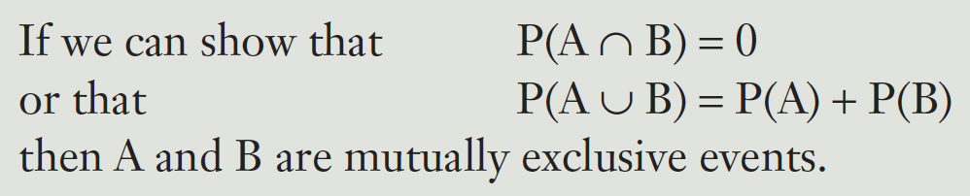
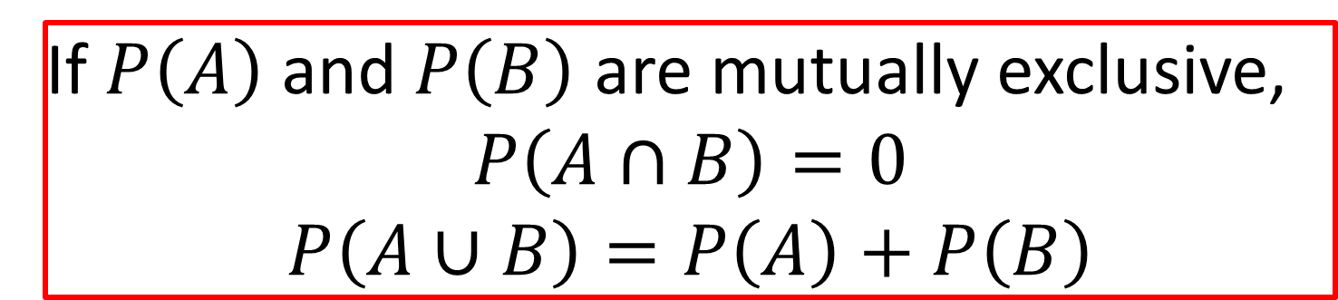
How does it affect the addition rule?
Concept Development
$$P\left(A∪B\right)=P\left(A\right)+P\left(B\right)−P(A∩B)$$
If $P\left(A\right)$ and $P\left(B\right)$ are mutually exclusive,
$$P\left(A∩B\right)=0$$
$$P\left(A∪B\right)=P\left(A\right)+P\left(B\right)$$

Slide 14
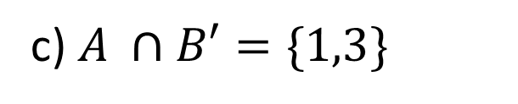
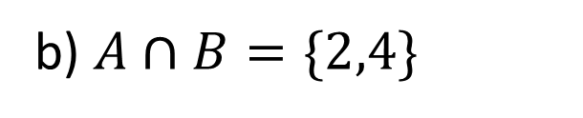
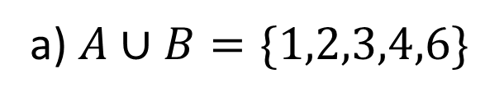
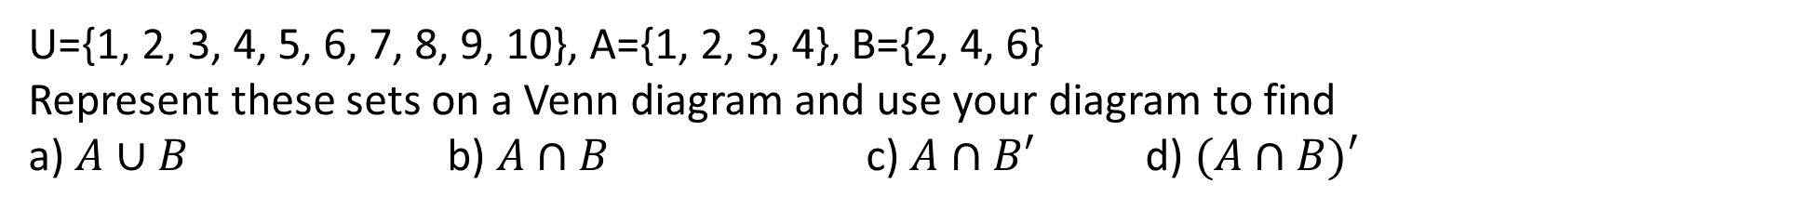
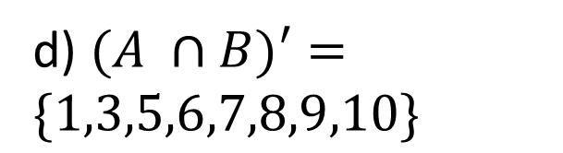
Guided Practice
U={1, 2, 3, 4, 5, 6, 7, 8, 9, 10}, A={1, 2, 3, 4}, B={2, 4, 6}
Represent these sets on a Venn diagram and use your diagram to find
a) $A∪B$ b) $A∩B$ c) $A∩B′$ d) $(A∩B)′$
a) $A∪B=\{1,2,3,4,6\}$
b) $A∩B=\{2,4\}$
c) $A ∩B′=\{1,3\}$
d) $(A ∩B)′=\{1,3,5,6,7,8,9,10\}$

Slide 15
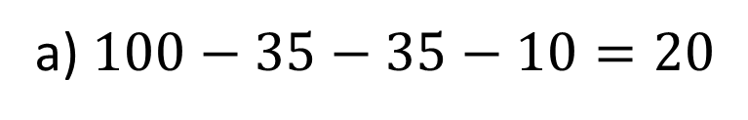
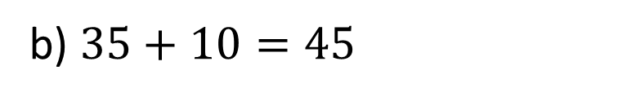
Guided Practice
In a survey of 100 university students, a market research company found that 70 students owned smartphones, 45 owned cars and 35 owned smartphones and cars. Use a Venn diagram to help you answer the following questions
How many students owned neither a car nor a smartphone?
How many students owned either a car or a smartphone, but not both?
a) $100−35−35−10=20$
b) $35+10=45$

Slide 16


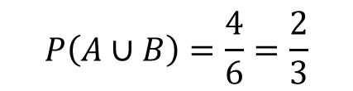



Guided Practice
U={1, 2, 3, 4, 5, 6}, where the outcomes are equally likely. If A={2, 4, 6} and B={3} find
a) $P(A∪B)$ b) $P(A∩B)$ c) $P(A^{′})$ d) $P(B^{′})$
a) $n\left(U\right)=6$
b) $n\left(A∩B\right)=0$
c) $P\left(A^{′}\right)=\frac{3}{6}=\frac{1}{2}$
d) $P\left(B^{′}\right)=\frac{5}{6}$
$$P\left(A∪B\right)=\frac{4}{6}=\frac{2}{3}$$
$$P\left(A∩B\right)=0$$

Slide 17

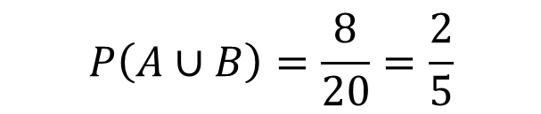

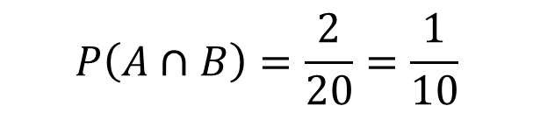
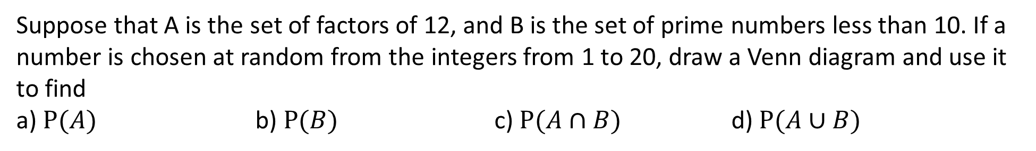


Guided Practice
Suppose that A is the set of factors of 12, and B is the set of prime numbers less than 10. If a number is chosen at random from the integers from 1 to 20, draw a Venn diagram and use it to find
a) $P(A)$ b) $P(B)$ c) $P(A∩B)$ d) $P(A∪B)$
$$A=\{1,2,3,4,6,12\}$$
$$B=\{2,3,5,7\}$$
$$P\left(A\right)=\frac{6}{20}=\frac{3}{10}$$
$$P\left(B\right)=\frac{4}{20}=\frac{1}{5}$$
$$P\left(A∩B\right)=\frac{2}{20}=\frac{1}{10}$$
$$P\left(A∪B\right)=\frac{8}{20}=\frac{2}{5}$$

Slide 18
Guided Practice
$$P\left(A∪B\right)=P\left(A\right)+P\left(B\right)−P(A∩B)$$
$$=0.5+0.4−0.2$$
$$=0.7$$

Slide 19

Guided Practice
$$P\left(A∪B\right)=P\left(A\right)+P\left(B\right)−P(A∩B)$$
$$P\left(A∩B\right)=P\left(A\right)+P\left(B\right)−P(A∪B)$$
$$=0.3+0.4−0.5$$
$$=0.2$$

Slide 20

Guided Practice
$$P\left(A∪B′\right)=P\left(A\right)+P\left(B′\right)−P(A∩B′)$$
$$P\left(A∩B′\right)=P\left(A\right)+P\left(B′\right)−P(A∪B′)$$
$$=0.3+0.6−0.2$$
$$=0.7$$

Slide 21
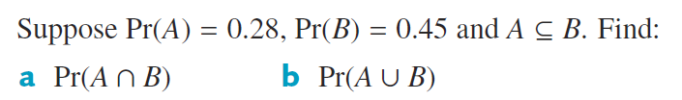
Guided Practice

Slide 22
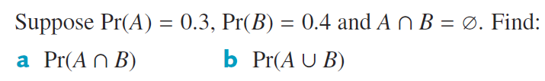
Guided Practice

Slide 23
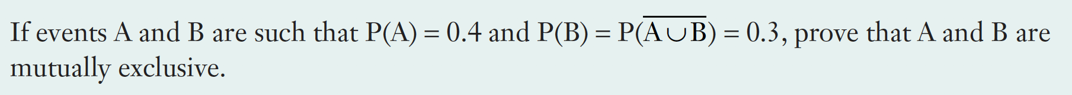

Slide 24
Independent Practice
Complete Ex 9C & D

